Slide 1
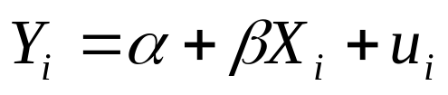
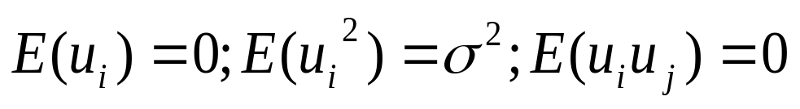
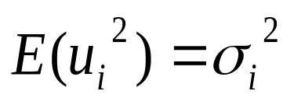
The Model:
We assume:
If , there is heteroscedasticity problem
The problem is likely to be more common in cross-sectional than in time-series data
The OLS estimators will be unbiased, consistent but not efficient , i.e., they are not BLUE
The estimated variances and covariance of the OLS estimators would be biased and inconsistent.
Method of weighted least squares (WLS) can satisfy BLUE properties if the heteroscedastic error variances are known

Slide 2

Why does Heteroscedastictiy Occur?
Outliers
Specification bias
Exclusion of variable(s)
Inappropriate Functional form
Skewness in the distribution of regressor(s)
Incorrect data transformation
Error-learning behaviour of the researcher
Changes in data collection techniques
Pooling of samples with structural differences

Slide 3

Detection of Heteroscedasticity:
Plot of the Residuals
The squared residuals are used as an estimate of the unknown and unobservable variance.
The squared residuals are plotted against an explanatory variable that might be related to the error variance.
If the error variance is likely to be related to more than one of the explanatory variables, the squared residuals should be plotted against each of these variables.
Alternatively, one can plot the squared residuals against the fitted values of the dependent variable.
However, this is not a formal test for heteroscedasticity. It only suggests whether heteroscedasticity may exist.
One should also carry out a formal tests to confirm the same statistically.

Slide 4
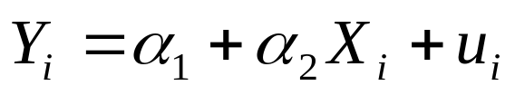
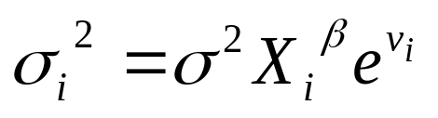
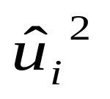
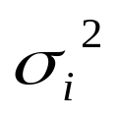
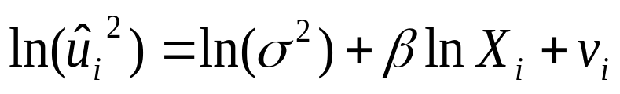
Park Test
Model:
Assumption:
Steps:
Run OLS for the original model
Use as a proxy for
Run OLS for
If β is statistically significant, heteroscedasticity is present
Limitation: vi may not satisfy OLS assumption and may itself be heteroscedastic

Slide 5
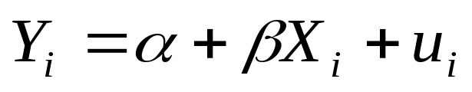
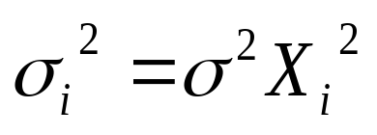
Goldfeld–Quandt Test
Model:
Assumption:
i.e., the heteroscedastic variance is positively related to the explanatory variable
Steps:
Arrange the observations in ascending order of X
Omit c number of central observations and divide the remaining (n-c) observations into two groups each of (n-c)/2 observations
Fit separate OLS regression for each of the groups and obtain RSS₁ and RSS₂

Slide 6
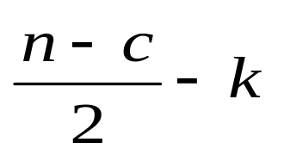
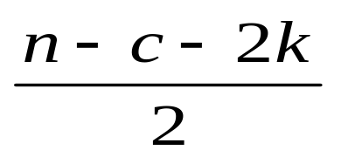
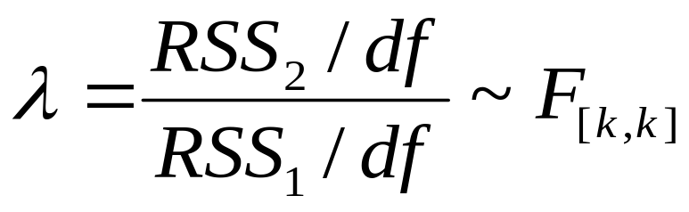
Each RSS has or degrees of freedom
4. Compute
5. If the computed value of F is greater than the critical value, the null hypothesis of homoscedasticity is rejected
6. Power of the test depends on and sensitive to c
7. Judge et al. suggest c = 4 if n = 30 (13%) whereas Goldfeld-Quandt suggest for c = 8 if n = 30 (25%)

Slide 7
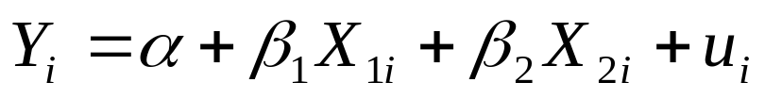
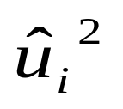
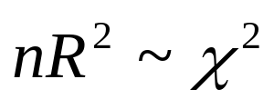
White’s General Test for Heteroscedasticity
Model:
Steps:
Estimate regression model and obtain
Run auxiliary regression
Calculate with degrees of freedom equal to the number of regressors (excluding the intercept)
The null hypothesis is that there is no heteroscedasticity. Thus, if the null hypothesis is rejected, there is heteroscedasticity problem.

Slide 8
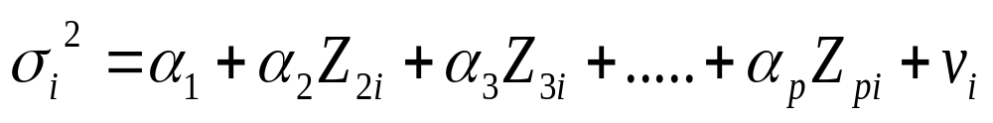
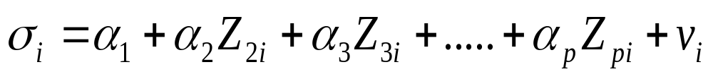
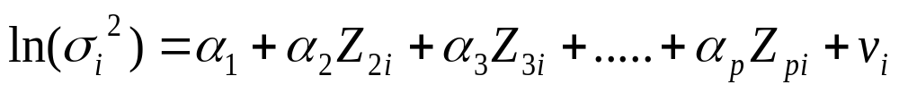
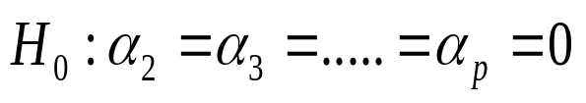
Lagrange Multiplier Test:
The test statistic is easy to calculate and a variety of alternatives can be covered
Model:
Assumptions:
(1)
(2)
(3)
Null Hypothesis:
When the null hypothesis is rejected, the estimated model suffers from the problem of heteroscedasticity

Slide 9
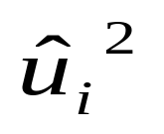
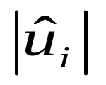
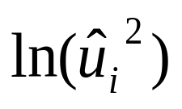
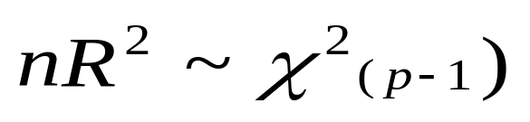
Steps:
Run OLS for the original model and obtain the estimated residuals
Use , , and for auxiliary regression with respect to (1), (2) and (3) respectively.
Compute the test statistic:
If the null hypothesis is not rejected, there is no evidence to support a conjecture of heteroscedasticity
The more accurately one knows the exact causes of heteroscedasticity, better the power of the test

Slide 10

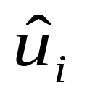
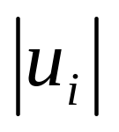
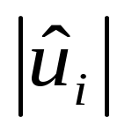
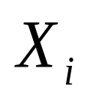

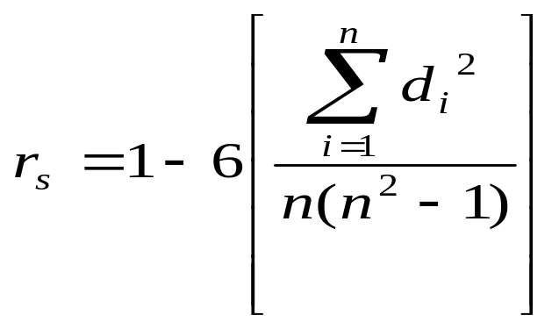
Spearman’s Rank Correlation Test
Model:
Steps:
Run OLS and obtain the estimated residuals
Ignore the sign of (take ) and rank this and (or ) in ascending or descending order
Compute Spearman’s Rank Correlation Coefficient by using the formula:
Here, d_{i}= Difference in ranks of Xi and

Slide 11
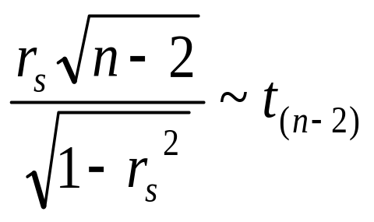
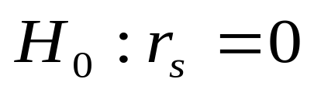
Compute the test statistic:
The null hypothesis:
If the null hypothesis is not rejected, the residuals satisfy the OLS assumption of homoscedasticity

Slide 12
Remedies to Correct Heteroscedasticity:
Use to OLS estimator to estimate the parameters of the model. If heteroscedasticity is detected, correct the estimates of variances and covariance of the OLS estimates so that they are consistent.
2. Use an estimator other than the OLS estimators such as GLS or WLS to estimate the parameters of the model.
Make log transformation of the variables
However, getting more precise estimates with an alternative estimator requires specifying approximate heteroscedasticity structure. Otherwise, alternative estimator can yield estimates that are worse than the original OLS estimator.

